Slide 1
How to Give an Academic Talk
This work is licensed under a Creative Commons Attribution-NonCommercial-ShareAlike 4.0 International License. The terms of this license allow you to remix, tweak, and build upon this work non-commercially, as long as you credit me and license your new creations under the identical terms.
Quasi-permanent URL: pne.people.si.umich.edu/PPT/howtotalkslides.pptx
Paul N. Edwards
School of Information and Dept. of History

Slide 2
Today
What public speaking is for, and why it’s hard
How to engage your audience
  Physical presence and vocal techniques
Using presentation software
Timing
Rehearsal: the key to success
Troubleshooting: handling difficult situations
Paul N. Edwards, University of Michigan
27 January 2017

Slide 3
Today
What public speaking is for, and why it’s hard
How to engage your audience
  Physical presence and vocal techniques
Using presentation software
Timing
Rehearsal: the key to success
Troubleshooting: handling difficult situations

Slide 4
Purposes of public speaking
Communicate arguments and evidence
Persuade audience that they are true

Slide 5
Communicate and persuade: content
What you wanted to know (questions)
How you investigated it (methods)
What you found out (claim)
How you know it’s true (evidence)
Limits and objections
Who cares? Why this matters to your audience

Slide 6
Structure
A talk is not a paper
    No possibility of review
What do you want your audience to remember?
  What can your audience remember?
Give away your main points, and repeat them
Help listeners follow you with navigational aids

Slide 7
Example of a navigational aid
Today
What public speaking is for, and why it’s hard
How to engage your audience
  Physical presence and vocal techniques
Using presentation software
Timing
Rehearsal: the key to success
Troubleshooting: handling difficult situations
Notes:
The longer the talk, the more you need these

Slide 8
Purposes of public speaking
Communicate
Persuade
Engage (excite, interest, entertain)
Notes:
Mistake: equate “engaging” with “superficial”

Slide 9
Why engage and entertain?
To communicate and persuade…
You need your audience’s full attention
…and your audience needs your help to maintain focus

Slide 10
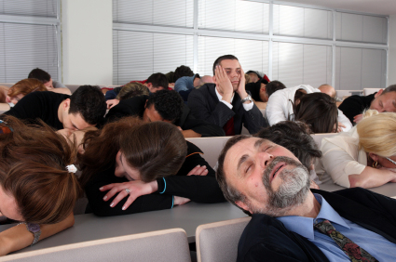
Listening is hard work
Conferences: many talks over many hours
Job searches: many candidates
Limits to human attention (~40 minutes)
Competing distractions
  Other talks
  Internet/email
  Other concerns

Slide 11
Today
What public speaking is for, and why it’s hard
How to engage your audience
  Physical presence and vocal techniques
Using presentation software
Timing
Rehearsal: the key to success
Troubleshooting: handling difficult situations

Slide 12
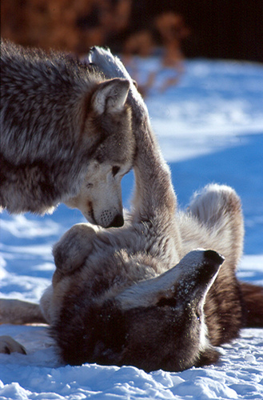
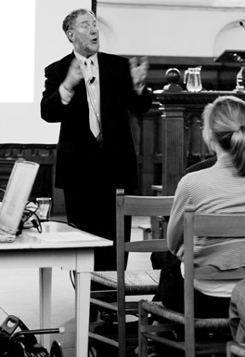
Engaging your audience
Physical presence
Be the dominant animal
  Stand up!
Make eye contact!
  …or at least look like it
  Don’t “side” the room
Talk – don’t read
Move around

Slide 13
Engaging your audience
Take control of the environment
Light
Temperature
Noise and distractions

Slide 14
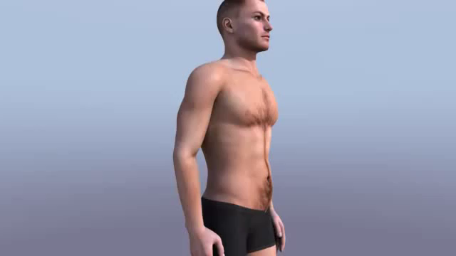
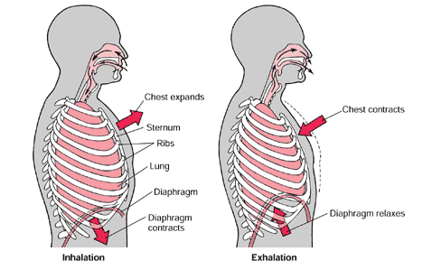
Engaging your audience
Vocal production
Loud and clear!
  Talk to the back row
Breathe!
Use the diaphragm
  Speak from the belly, not the head
  Belly opens on inhale, contracts on exhale
Use sound reinforcement

Slide 15
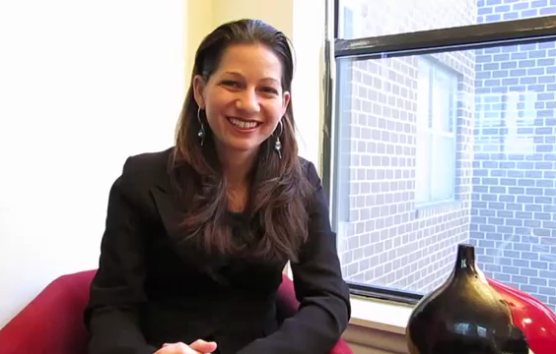
Engaging your audience
Vocal technique: things to watch out for
Uptalk
The sound of authority: speak at the low end of your range
Monotone
Like, y’know, ummmm, sort of…

Slide 16
silence
is part of speech

Slide 17
Emulate excellent speakers
Not just what they say —
But what they do

Slide 18
Today
What public speaking is for, and why it’s hard
How to engage your audience
  Physical presence and vocal techniques
Using presentation software
Timing
Rehearsal: the key to success
Troubleshooting: handling difficult situations

Slide 19
Using presentation software
Less is more
Text: keep it simple
Use images!
Slide backgrounds: simple, bright

Slide 20
this makes the room really dark

Slide 21
Using presentation software
Less is more
Avoid glitzy backgrounds and special effects

Slide 22
About Powerpoint
Less is more
  20-30 words per text slide
  USE images
  USE ability to have many slides
Practice!
  Don’t watch screen -- use your laptop or notes
Slide backgrounds: simple, bright
Backup, backup

Slide 23
About Powerpoint
Less is more
  20-30 words per text slide
  USE images
  USE ability to have many slides
Practice!
  Don’t watch screen -- use your laptop or notes
Slide backgrounds: simple, bright

Slide 24
Using presentation software
Less is more
Too much complexity makes slides hard to interpret

Slide 25
R_{s} calculated using Fick’s 1º law of diffusion using Moldrup et al. 1999 model
Critical parameters:
CO₂, θ, Τ, P,φ ,ρ, τ
Flux= -D_{s} δC/δz
D_{s}/D_{a}= ετ = ξ, D_{s}=ξD_{a}
ξ= φ²(ε/φ)^{βs}
s= silt + sand
φ = 1− (ρ_{b}/ρ_{m})=ε + θ
Notes:
Instead of turbulence as the problem feature, soil flux issues involve barriers to flow including θ (water), which absorbs as well as blocks CO2 diffusion, porosity (φ) which is the air-filled pore space, T regulating diffusion rates, barometric pressure (P) of the atmosphere affecting concentration deficit, and tortuosity (Γ) determining the complexity of the pathway. Γ, and φ are derived from measurements of soil texture, other parameters come from sensors. b is bulk density and m is particle density, ξ is tortuosity factor, ε is air filled porosity

Slide 26
R_{s} as a function of T, θ

Slide 27
other ways to use powerpoint

Slide 28
just a word

Slide 29
or an image

Slide 30
climate change

Slide 31
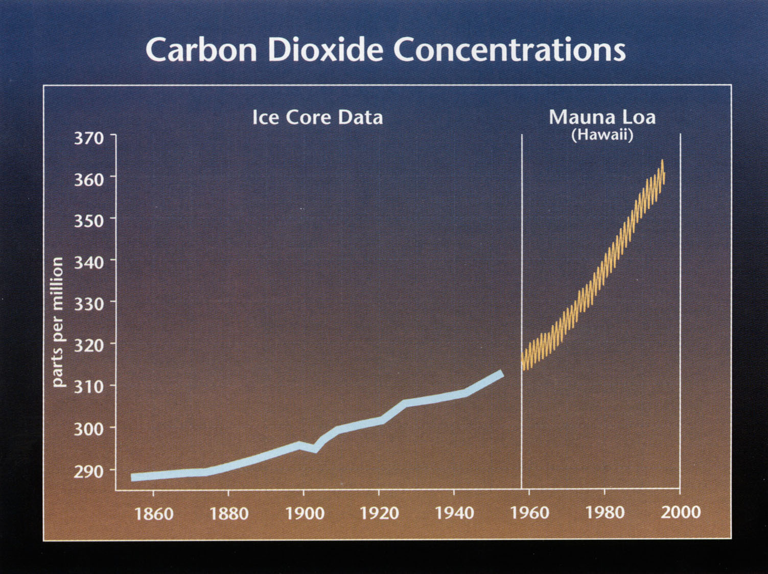

Slide 32
even more radical:
don’t use it

Slide 33
Using presentation software
Less is more
If you use video: keep it short
Talk to the audience — not the screen!
  Use notes on paper, or on your laptop

Slide 34
Today
What public speaking is for, and why it’s hard
How to engage your audience
  Physical presence and vocal techniques
Using presentation software
Timing
Rehearsal: the key to success
Troubleshooting: handling difficult situations

Slide 35
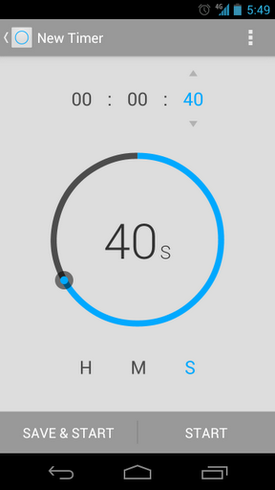
Timing
Respect your audience, and your colleagues: finish on time!!
Use a timer
Know what you can skip…
  …and it’s not your conclusions.
Develop a standard slide length
Don’t draw attention to mistiming

Slide 36
Today
What public speaking is for, and why it’s hard
How to engage your audience
  Physical presence and vocal techniques
Using presentation software
Timing
Rehearsal: the key to success
Troubleshooting: handling difficult situations

Slide 37
Practice, practice, practice!
Rehearsal matters more than slide prep
Time yourself
Improvising? Practice, and account for the time!
Practice talks: simulate real conditions

Slide 38
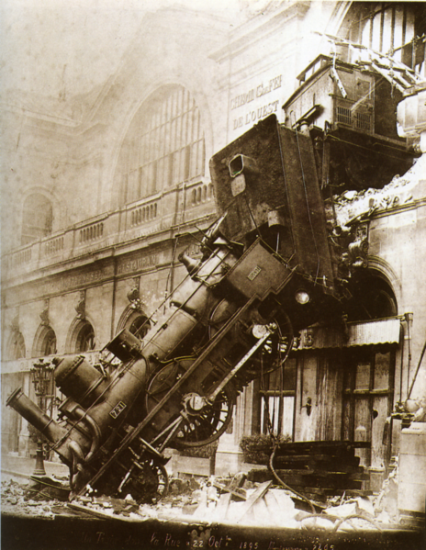
Murphy’s Law: planning for disaster
Use your own laptop
Backup, backup, backup!!
Bring a printout
Imagine (and plan for) the worst possible audience

Slide 39
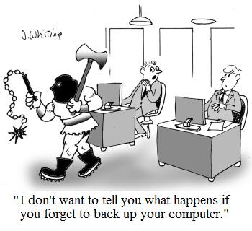
_{Once again, that’s} backup, backup, backup…

Slide 40
Today
What public speaking is for, and why it’s hard
How to engage your audience
  Physical presence and vocal techniques
Using presentation software
Timing
Rehearsal: the key to success
Troubleshooting: handling difficult situations

Slide 41
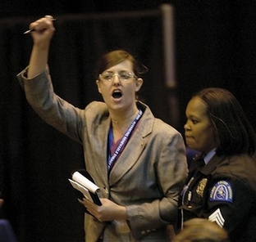
Troubleshooting: difficult people
Interruptions
Heckling
Aggressive questioners
Won’t give up the floor

Slide 42
Troubleshooting: vocal problems
High-pitched voices
Quiet voices
Second-language issues

Slide 43
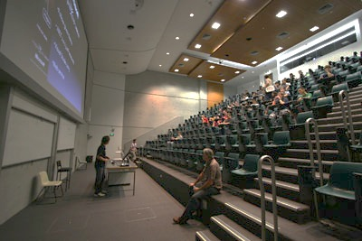
Troubleshooting: difficult rooms
Dark
Large, without sound reinforcement
Steep pitch

Slide 44
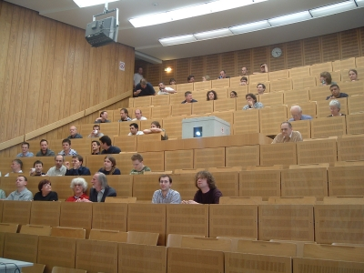
Troubleshooting: difficult audiences
Very small
Not your field
Hostile

Slide 45
Summing up: usually better…
Talk
Stand and move
Speak loudly
Face the audience
Make eye contact
  or fake it
Respond to audience needs
Focus on main arguments
Provide navigational aids
Use images
Summarize at beginning and end
Finish within time limit
Rehearse

Slide 46
Thanks!
To all my collaborators: Keila Smale, Olive Eakes, Alexandria Charboneau, Enedina Anzaldua, Contessa Foose, Emil Genna, Rhea Felt, Raul Stogsdill, Vania True, Scarlet Carpino, Deneen Beatty, Princess Gamble, Babara Abila, Katina Richardson, Karl Boulanger, Larry Schuman, Jerome Aliff, Sheryll Flavell, Ute Dupras, Carly Hadsell

Slide 47
Questions?

Slide 48
_{End with the ending!}
Summing up: usually better…
Talk
Stand and move
Speak loudly
Face the audience
Make eye contact
  or fake it
Respond to audience needs
Focus on main arguments
Provide navigational aids
Use images
Summarize at beginning and end
Finish within time limit
Rehearse

